Slide 1
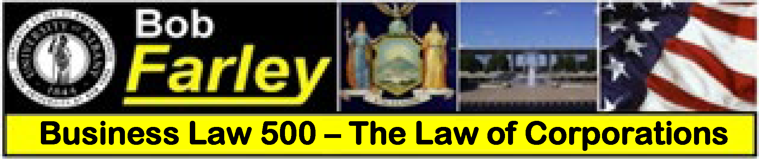
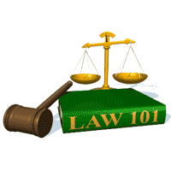
Slide Set Two A:
Nature of a Corporation

Slide 2

Last Time – We Spoke About:
Website: www.bobfarley.us
Your Biography: If you haven’t already, please hand it in.
Class Schedule:
http:/www.bobfarley.us/300lawclasses/350corporationlaw/schedule.pdf
Class Syllabus:
http:/www.bobfarley.us/300lawclasses/350corporationlaw/syllabus.pdf
Class Format and Grading Information:
http:/www.bobfarley.us/300lawclasses/350corporationlaw/format.pdf
Contact Us:
Email – bobfarley@bobfarley.us
Phone/Text – (518) 986-2037
In Person – By Appointment

Slide 3
Tonight – We Will Speak About:
The Nature of a Corporation
Part One: Origins of the Corporation / Definitions / Artificial Person
The Types of Corporations
Part Two: 1. Business Corporations
2. Professional Corporations
3. Public Purpose Corporations
4. Not for Profit Corporations
Elements of a Corporation
Part Three: Principal Characteristics / Comparisons / Powers
Class Case – Dartmouth College v. Woodward
Recognition of Corporate Personhood

Slide 4
The Nature of Corporations
Generally
WHAT IS A ''CORPORATION''
A corporation is a legal entity (an artificial person) created in accordance with statutes.
The corporation is a creature of law, a legal construct.
No one has ever seen one.
The corporation’s existence and attributes arise from state-enabling statutes, which give business participants significant freedom to choose their own customized relationships.
The corporate entity is separate and distinct from the legal personalities of those who own and manage the corporation.
In New York, as elsewhere, corporate law is mostly statutory, and most of the statutory law relating to general business corporations (i.e., corporations for profit) is contained in the New York Business Corporation Law ("BCL").

Slide 5
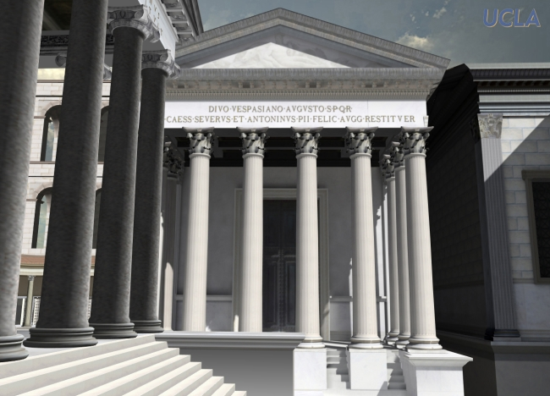
The Nature of Corporations
The Origins of Corporations
A. It All Started With Trade and Markets
The Roman Economy:
Rome: The Foundation of Law: The Romans were the first society to develop a true sophisticated economy with many vehicles of business organization.
Society Not The Individual: With a principle that
Roman society was perpetual and everlasting,
grew a concept that there were matters greater
than any one person, and that things that would
survive well past any individual’s natural lifetime.
Rome Believed in Rules: With developing legal
systems, the Romans also created a modern
division of labor, together with many of the
business organizations we would recognize today.
Early Roman Business Organizations: From
sole proprietorships to partnerships to corporations, Roman law established
a wide variety of business organizations to advance its economy.
The Greatness of Rome – Its Economy: An economic powerhouse, Rome’s
legal innovations were imitated for generations to come.
The Corporation: One of Rome’s most notable inventions, was the corporation, from the Latin word “corpus”, meaning body, where a business could take on a life as an artificial person and last perpetually beyond the lifetime of any person.

Slide 6
The Nature of Corporations
The Origins of Corporations
B. The Rise of the Corporation
Roman Law:
Founded in Rome: The modern corporation is actually of ancient origin, and like most things created from Rome, it arose as a practical solution to fill a need, and adapted as the needs of society changed.
Based in Roman Law: The first corporation type entities date all the way back to ancient Rome, and arose when Roman commerce and trade grew to a sophisticated level, and traders and merchants needed a business organization that could last beyond a person’s natural lifetime and have its own identity before the courts.
Practical: As a result, seeing the need to advance their trade and commerce, Roman law evolved the legal concept of the corporation, establishing a new type of business organization, authorized by the state, and recognized in law.
An Artificial, Separate, Person Under the Law: This Roman legal invention was treated as if it had a distinct personality apart from that of its owners or members, continued to exist beyond their lifetime, and was allowed to bring an action in law before Roman courts as a distinct entity rather than under the name of any individual.
What’s in A Name: This Roman legal invention was termed “corporation”, meaning a business entity which is viewed as a separate and independent legal person under the law. It is a derivation of the Latin term “corpus” meaning “body”.

Slide 7
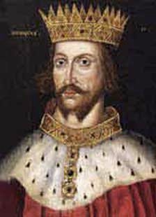
The Nature of Corporations
The Origins of Corporations
B. The Rise of the Corporation
English Law:
England Evolves Roman Law: These Roman principles were
resurrected into English Law as early as the 12th century.
Paralleled the Common Law: The corporation was first brought into
the Anglo-American Legal System by Henry the Second.
His innovations also developed much of we know today as the English
Common Law.
More than Just Business: King Henry adapted the concept of the
Roman corporation to meet his needs of governmental organization and public infrastructure development.
He used the sovereign authority to create fictitious legal persons through the granting of Royal charters.

Slide 8
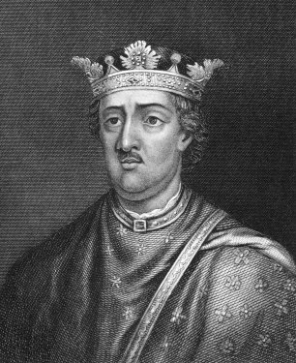
The Nature of Corporations
The Origins of Corporations
B. The Rise of the Corporation Continued:
English Law Continued:
Application to Business: Later rulers, then expanded this idea
of the corporation by employing the corporate mechanism to establish
trade guilds.
These organizations would establish by-laws to govern all persons engaged
in a specified field (such as weavers, tailors, goldsmiths, and haberdashers).
A British Staple of Law: By the time of the founding of Colonial America,
the corporation attained a status in the social constitution of Great Britain and its colonies.
Expanded to Meet Economic Needs: As the needs of English society changed, the corporation was further developed.
To meet these needs, British royal sovereigns began to grant charters for such purposes as
constructing public works projects such as churches, hospitals, universities, waterways and canals.
A Means to Colonize: By the start of the 17th century, as England arose to the stature of a
world superpower, Queen Elizabeth decided to deploy the corporation format to extend national
influence into the area of colonization.
Chartering such entities as the East India Trading Company, the Hudson’s Bay Company, the
Virginia Company and the Massachusetts Bay Company, England became the British Empire,
using corporate powers to develop, settle and institute commercial operations all across the globe.

Slide 9
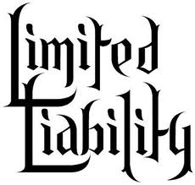
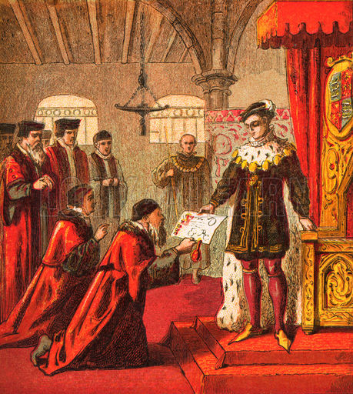
The Nature of Corporations
The Origins of Corporations
B. The Rise of the Corporation Continued:
English Law Continued:
Corporations as a Tool of Government and Business: These corporations were thus developed into a tool, granted by a king, to extend his rule and power, using
the initiative of private individuals, to accomplish certain public purposes.
The Rise of Limited Liability: Most importantly, starting with the joint
stock corporation, such charters could also provide, as aforementioned,
for an extension of sovereign immunity, so as to limit the liability and financial
exposure of corporate investors to only the amount of their investment.
A Powerful Mechanism: Accordingly, perhaps the most important
factor, which has led to the dominance of the corporation as a
business organization entity, is the development of this limited
liability attribute.
Original and Novel: At the time of its first inclusion in corporate
charters, the concept of limiting one’s liability to only the amount
of their capital investment was not otherwise anywhere else
recognized at common law.

Slide 10
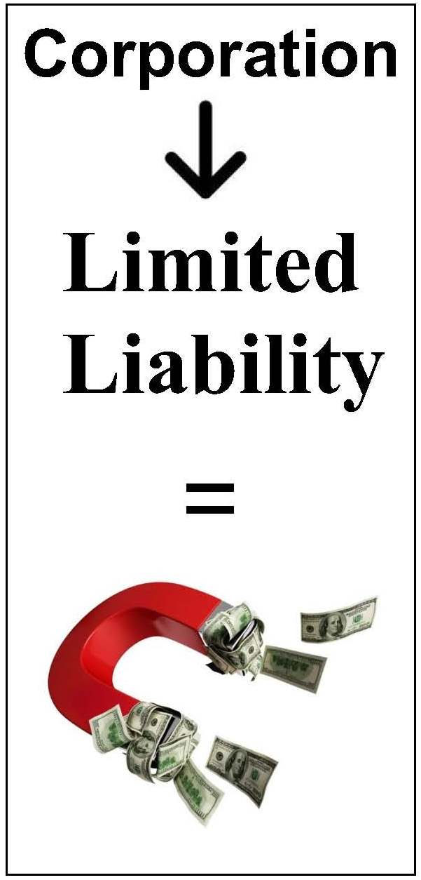
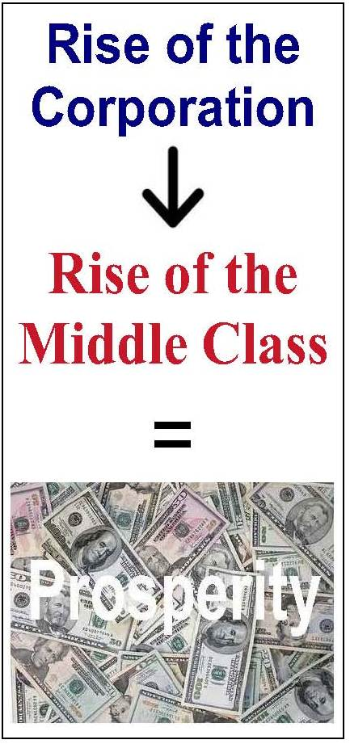
The Nature of Corporations
The Origins of Corporations
B. The Rise of the Corporation Continued:
English Law Continued:

Slide 11
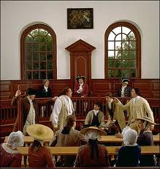
The Nature of Corporations
The Origins of Corporations
B. The Rise of the Corporation
Colonial America:
British Law Operated in the Colonies: By the time of the founding
of Colonial America, the corporation was a well settled institution within the
English Common Law. Under such, it had attained extensive acceptance
and application in the domain of business. As a result, it is therefore not
surprising that from a very early date, the corporation played a prominent role
in American life.
Most Businesses Were Not Corporations: Despite the myriad
of business organizations available under English Law, the business landscape of Colonial America
contained only a handful of Corporation and was dominated by sole proprietorship businesses.
A Small But Growing Economy: As the American Colonies began to grow and prosper, they began to move toward independence from England. The pull of freedom was very strong. From farmers to merchants, single persons owned and worked their own businesses. Their sense of self reliance and independence was very strong. Although most people still were engaged in small businesses, with the growth of the economy, their new sense of an independent future, many began to envision a day when a growing number of businesses, would grow large enough to need a corporate charter.
Another Reason for Rebellion: In all of America, however, there were only 335 corporate charters granted by the British sovereign. This unwillingness to treat American businesses as equal their English Counterparts, only underscored America’s desire for independence. They wanted freedom, including freedom to pursue their economic dreams in the manner they wished.

Slide 12
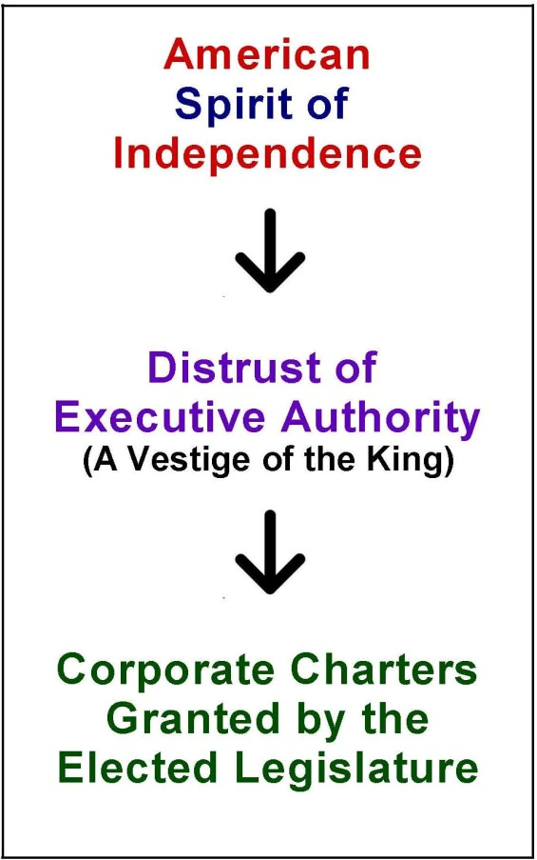
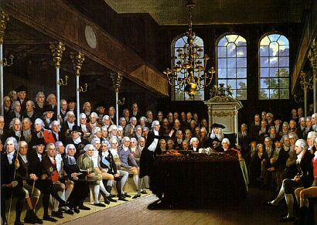
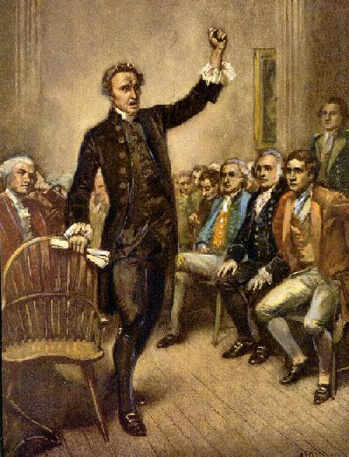
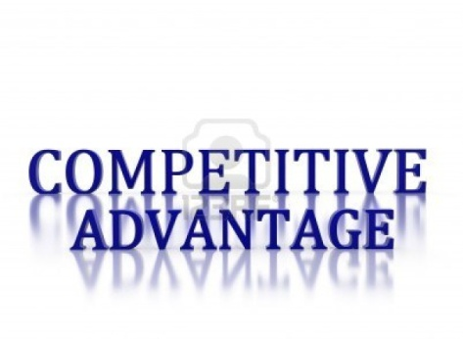
The Nature of Corporations
The Origins of Corporations
B. The Rise of the Corporation
Colonial America Continued:
Competitive Advantage for Corporations: Those businesses, that
did maintain the corporate form had a competitive advantage. They operated
with the formidable strength and capital of limited liability, and the purpose
and power of the state.
Another Unfair Power of the Crown: With the dawn of the American
Revolution, all edicts of the Crown, including the corporation, became circumspect.
As the denunciation of the king, and “his long train of abuses”, became a rallying
cry for American independence, this unfettered exercise of the state’s authority by
the British King, selectively granting corporate charters to British businesses, while
denying them to Americans, was seen by the founders as another impediment
against a truly free society.
British Parliament Began Granting Charters Too: Concurrently, at this
same time the British Parliament also began to more frequently deploy its own
legislative power to create corporations through the issuing of charters by statute.
They were, however equally stingy in granting them to American concerns.
State Legislatures Began to Grant Corporate Charters: After the
Revolution, corporate charters throughout America, began to be granted to
individuals by special acts of their state legislature.

Slide 13
The Nature of Corporations
The Origins of Corporations
B. The Rise of the Corporation
New York’s General Incorporation Policy:
In 1846 the modern method of forming business corporations
was born in New York State.
Although slightly amended in 1894, and then renumbered in 1938,
the present text of Article 10, section 1 of the New York State Constitution,
was essentially drafted during the 1846 convention, to read as follows:
“Corporations may be formed under general laws; but shall not be created by
special act, except for municipal purposes, and in cases where, in the
judgment of the legislature, the objects of the corporation cannot be attained
under general laws. All general laws and special acts passed pursuant to this section may be altered from time to time or repealed.”
Through this provision, New York State established the policy
of allowing businesses to incorporate by filing,
pursuant to a series of qualified rules established by statute.
(Now known as the Business Corporation Law).
As a result, businesses no longer needed a special act of the state legislature
to obtain corporate personhood through a charter granted
by an individual dedicated law.

Slide 14
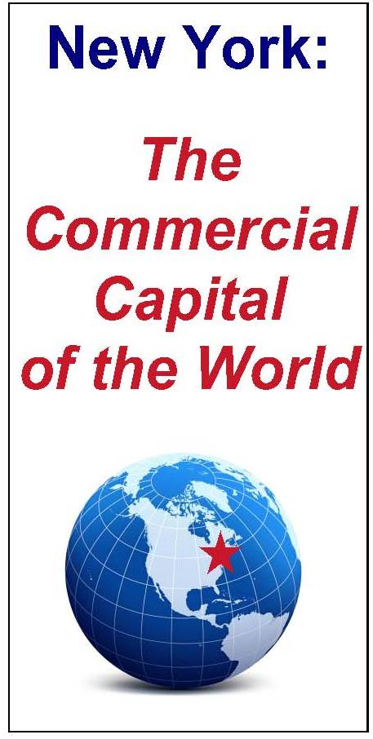
The Nature of Corporations
The Origins of Corporations
B. The Rise of the Corporation
New York’s General Incorporation Policy Continued
Effect of the Constitutional Amendment: This constitutional amendment,
and the enabling statutes that followed, had the effect of transferring the
monitoring of corporations from the legislature (through the crafting of a special
laws awarding a charter) to the courts (through the administration of justice for
statutory compliance).
Exponential Increase In Corporations: The amendment further resulted
in an exponential increase in corporate organizations and provided the impetus
to make New York State the commercial capital of the nation.
As Corporations Grow, Business Grows: As a consequence, by the
time of the civil war, just fifteen years later, New York State developed a gross
domestic product index over four times that of all the confederate states
combined.
Corporate Personhood: In addition to the provisions outlined in Article 10,
Section 1, the 1846 State Constitutional Convention also provided for a direct
expression of corporate personhood. Again, although slightly amended in 1894,
and then renumbered in 1938, the present text of Article 10, Section 4 of the
NYS Constitution, was essentially drafted during the 1846 Convention, to read
as follows:
“The term corporations as used in this section and in sections 1 (the power to make general incorporation statutes), 2 (the power to hold incorporators liable for dues of the corporation) and 3 (limiting the legislature’s ability to make special charters just for banking purposes) of this article shall be construed to include all associations and joint-stock companies having any of the powers or privileges of corporations not possessed by individuals or partnerships.
And all corporations shall have the right to sue and shall be subject to be sued in all courts in like cases as natural persons.”

Slide 15
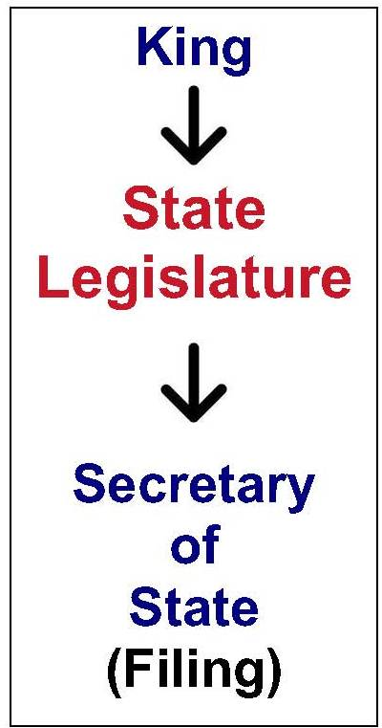
The Nature of Corporations
The Origins of Corporations
B. The Rise of the Corporation
New York’s General Incorporation Policy Continued
Almost immediately, upon the ratification of these amendments,
enabling corporation statutes also began to evolve.
From that time to the present
we have thereupon seen the enactment
of such controlling corporation laws as:
    the Business Corporation Law,
    the Benevolent Orders Law;
    the Cooperative Corporations Law;
    the Limited Liability Companies Law;
    the Not for Profit Corporations Law;
    the Religious Corporations Law; and
    the Transportation Corporation Law.
    But it should be remembered, that it was from this 1846 framework,
    that the modern New York State Corporation was established,
    as well as the body of corporate law that exists today.

Slide 16
The Nature of Corporations
The Origins of Corporations
B. The Rise of the Corporation
The Rise of Federal Regulation:
State Law Still Predominates: Although, as aforementioned, nearly all law of business organizations are state law, starting around 1900, the United States Federal Government did begin to enact certain, specific federal laws. Despite this, it should be known, that State laws, such as the New York State Martin Act, the Wicks Law, the General Business Law, and the regulations of the Department of Financial Services still predominate, even after the enactment of federal business regulations.
Federal Entry into the Corporate Arena: The first major federal commercial law was the Sherman Anti-Trust Act enacted in 1890, which required that businesses could not maintain unfair monopolies, and that the free market must be afforded competition among businesses.
Depression Era Federal Regulation: Then commencing as a result of the 1929 stock market crash, in 1933, Congress began to enact certain federal securities laws (The Securities Act of 1933 – which established the Securities and Exchange Commission and established certain rules governing the stocks issued by business corporations, that are publically traded as marketable securities and the SEC Act of 1934 which established the Federal Securities and Exchange Commission).
Modern Era Federal Regulation: Additional Federal Statutes, such as the Sarbanes-Oxley corporate reform laws (2002), now require generally accepted accounting principles, corporate board financial rules and certain disclosure requirements for all publically traded companies. Moreover, with the passage of the Dodd-Frank law (2010), such federal regulations have become even more intrusive into the state domain.

Slide 17
The Nature of Corporations
Definitions
A. Types of Business Organizations
- Individual (Sole) Proprietorships
- Partnerships
- Corporations
Business Corporations,
Professional Corporations,
Public Benefit Corporations, and
Not for Profit Corporations
- Limited Liability Companies
L.L.C.’s and L.L.P’s
- Organizations
Joint Ventures,
Unincorporated Associations,
Co-operatives, and
Franchises

Slide 18
The Nature of Corporations
Definitions
B. Forms of Business Organizations
• The four principal forms of business organizations are:
– Sole Proprietorships,
– Partnerships,
– Corporations, and
– LLP’s and LLC’s
• The selection of the form of organization is determined by:
– Nature of the business,
– Tax considerations,
– Financial risk involved,
– Importance of limited liability, and
– The extent of management control desired.

Slide 19
The Nature of Corporations
Definitions
B. Forms of Business Organizations
Private Corporations
  Business Corporations
    Foreign / Domestic
    Close / Publically Traded
  Professional Corporations
  Subchapter S Corporations
Public Corporations
  Public Benefit Corporations
    Public Authorities
  Municipalities
Not- for – Profit Corporations

Slide 20
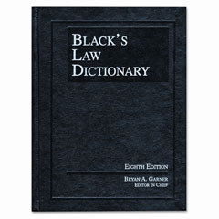
The Nature of Corporations
Definitions
C. Corporation Defined
Black’s Law Dictionary defines a
Corporation as:
“An artificial person or legal entity
created by or under the authority
of the laws of the state or nation,
which has an existence distinct from that
of its associated individuals,
and has a duration that is either perpetual
or for a limited term of years,
and which acts as a unit
in matters relating to the common purpose of the association
and within the scope of the powers conferred upon it by law.”

Slide 21
The Nature of Corporations
Definitions
MEANING OF ''CORPORATION''
A corporation is a legal entity (an artificial person) created in accordance with statutes.
The corporate entity is separate and distinct from the legal personalities of those who own and manage the corporation.
In New York, as elsewhere, corporate law is mostly statutory, and most of the statutory law relating to general business corporations (i.e., corporations for profit) is contained in the New York Business Corporation Law ("BCL").

Slide 22
The Nature of Corporations
Corporate Personhood
Corporations as Artificial Persons Under the Law:
Recognition of the separate legal personality of the corporation, separate from its shareholders, goes back centuries. Indeed the very word corporation stems from the latin “corpus” meaning body.
Since the early days of the Republic, the courts have seen the corporation as an "artificial person under the law" in the terms expressed by the English authorities, Coke and Blackstone.
As Chief Justice Marshall put it:
“A corporation is an artificial being, invisible, intangible, and existing only in contemplation of law. Being the mere creature of law, it possesses only those properties which the charter of its creation confers upon it, either expressly or as incidental to its very existence.”
The corporation is a creation of the legislature with certain "core“ rights including the capacity to sue and be sued, the capacity to hold and transfer property, and to have perpetual existence, irrespective of any change in its shareholders.
As an artificial person, corporations have been found by courts to have many of the same rights as natural people, including the right to free speech, the right of equal protection, by have also been found to not have all the rights of a natural person, such as the right to vote, the right of privileges and immunities (whereby states can thereby discriminate against out of state corporations) and the 5th amendment right against self incrimination.

Slide 23
End of Class Two A
For next time – Review Assignments as follows on the Webpage:
  Lecture Slides
  Selected Readings
  Cases and Exercises
We are a hot bench.
Questions?

