Slide 1
Slide Set Eight B:
Corporate Governance – Specific Officers

Slide 2
Last Time We Spoke About:
Corporate Governance – Boards of Directors
Board Members
Part One: Definitions / Roles / Obligations and Duties / Liabilities
Board Member Powers
Part Two: Generally / Chairman / Board Members / Committees
Corporate Personhood
Part Three: Generally / Fiduciary Responsibilities / Personhood Interests
Class Case – Citizen United v. FEC
The Constitutional Rights of Corporations

Slide 3
Tonight We Will Speak About:
Corporate Governance – Officers and Employees
Corporate Officers
Part One: Definitions / Roles / Obligations and Duties / Liabilities
Specific Officers
Part Two: CEO / President / Vice President / CFO / Treasurer / Secretary
Employees and Agents
Part Three: Definitions / Employees / Agents
Class Case – Miller v. McDonald
Compliance and Internal Control Enforcement

Slide 4
Part One:
Corporate Governance
Corporate Officers – Roles and Duties

Slide 5
Corporate Governance
Corporate Officers – Specific Officers
What corporate officers do:
Chief Executive Officer – The highest ranking officer in the corporation – responsible as the corporation’s lead agent, and performs the following duties:
Decides whom to hire and fire as agent or employee;
Responsible for the day to day management of the business;
Oversees the other employees (and to limited extent other officers as they are appointed and overseen by directors);
Signs contracts on behalf of the corporation;
Negotiates on behalf of the corporation (pursuant to the parameters set by the board of directors); and
Delegates his authority to other officers or employees (as allowed by the board of directors).
Responsible under the Sarbanes Oxley Act for the signing and verification of corporate reports (such as annual reports)

Slide 6
Corporate Governance
Corporate Officers – Specific Officers
What corporate officers do:
President – If no separate Chief Executive Officer, the president is the highest ranking officer in the corporation – and is responsible as the corporation’s lead agent, and performs the duties as set forth previously for the CEO, or as assigned by the corporate bylaws or the Board of Directors.
Vice President - Corporate vice-presidents generally have very little to do with the day-to-day function of a corporation. Usually, they are only authorized to take action in specific situations, such as when the corporate president is unavailable. Sometimes they are the head of a division the corporation or set in charge of a function (such as Head of Light Bulb Manufacturing Division or Consumer Affairs/Relations)

Slide 7
Corporate Governance
Corporate Officers – Specific Officers
What corporate officers do:
Chief Financial Officer – The Chief Financial Officer or CFO is the officer responsible for the finances, and accounting of the finances, of the corporation. Together with the Chief Executive Officer, the CFO must also verify the accuracy of reports under the Sarbanes Oxley Act.
Treasurer – If the corporation does not have a separate, Chief Financial Officer, the treasurer serves as the officer responsible for the finances, and accounting of the finances, of the corporation. The treasurer is the officer responsible for maintaining records of the corporation’s finances and ensuring that all corporate checking accounts, revenues, and accounts receivable are accurate and up-to-date.

Slide 8
Corporate Governance
Corporate Officers – Specific Officers
What corporate officers do:
Secretary – The Secretary is the officer responsible for the maintaining nonmonetary records for the corporation. The corporate secretary is responsible for sending out/transmitting all notices and documents from the corporation.
They are the officer that keeps the corporate seal, and who keep all records of the shareholder and directors’ meetings.
The secretary must also ensures that proper documentation is filed with the state secretary of state’s office, or any other required corporate filing.

Slide 9
Part Two:
Corporate Governance
Corporate Employees – Management of Corporation

Slide 10
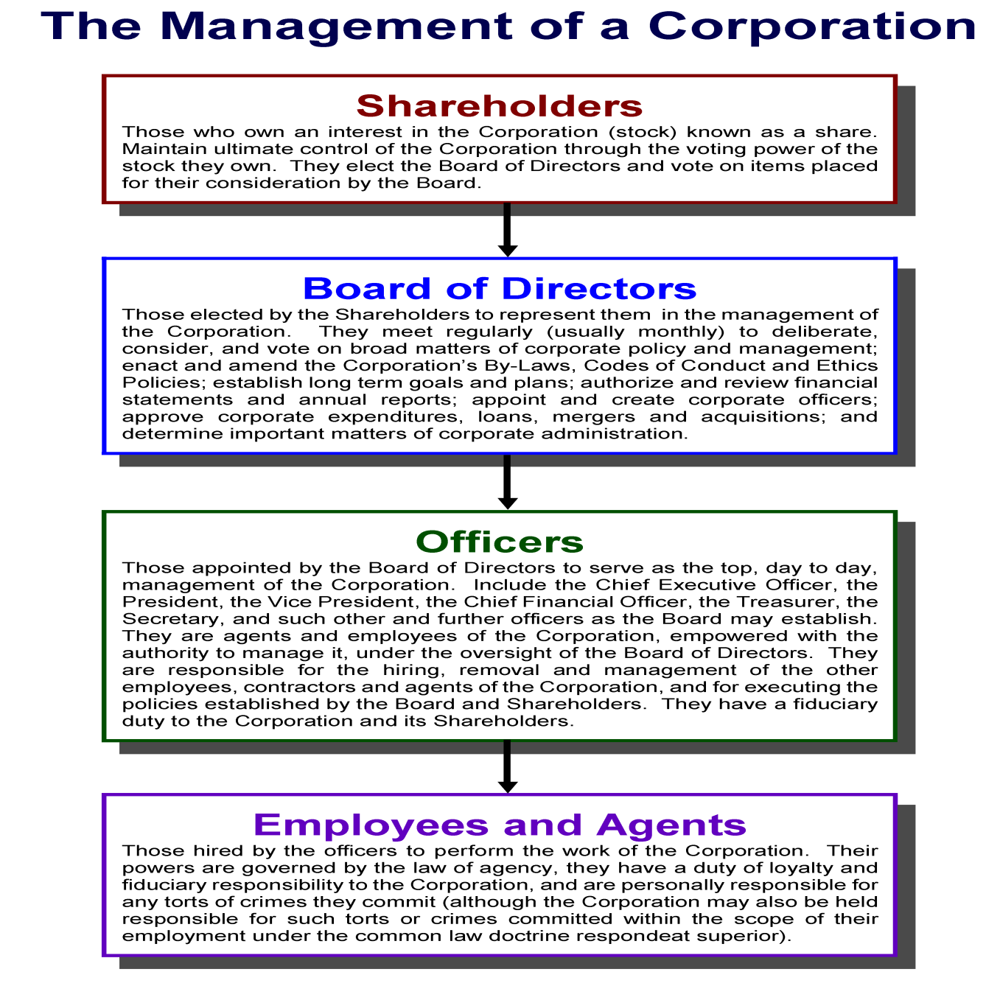

Slide 11
End of Class Eight B
For next time – Review Assignments as follows on the Webpage:
Lecture Slides
Selected Readings
Cases and Exercises
We are a hot bench.
Questions?

