Slide 1
Slide Set Eight C:
Employees and Agents

Slide 2
Last Time We Spoke About:
Corporate Governance – Boards of Directors
Board Members
Part One: Definitions / Roles / Obligations and Duties / Liabilities
Board Member Powers
Part Two: Generally / Chairman / Board Members / Committees
Corporate Personhood
Part Three: Generally / Fiduciary Responsibilities / Personhood Interests
Class Case – Citizen United v. FEC
The Constitutional Rights of Corporations

Slide 3
Tonight We Will Speak About:
Corporate Governance – Officers and Employees
Corporate Officers
Part One: Definitions / Roles / Obligations and Duties / Liabilities
Specific Officers
Part Two: CEO / President / Vice President / CFO / Treasurer / Secretary
Employees and Agents
Part Three: Definitions / Employees / Agents
Class Case – Miller v. McDonald
Compliance and Internal Control Enforcement

Slide 4
Part One:
Corporate Governance
Corporate Employees - Definitions

Slide 5
Corporate Governance
Corporate Employees – Definitions
Definitions:
Employment Defined: Black’s Law Dictionary defines “Employment” as:
1. Act of employing or state of being employed; or
2. That which engages or occupies; or
3. That which consumes time or attention; or
4. An occupation, profession, trade, post or business.
A Simple definition of “Employment” is:
“An act to engage or hire one’s service, in return for payment for such service.”
The Labor Law’s Definition of “Employment” is:
A relationship where someone is “permitted or suffered to work”
Corporation Employees: Has been held to include all individuals who are employees of Corporation, including unionized (collectively bargained), non-unionized (non collectively bargained), part-time, full-time employees, or individuals engaged on contract to provide employment services or sales to Corporation.

Slide 6
Part Two:
Corporate Governance
Corporate Employees - Generally

Slide 7
Corporate Governance
Corporate Employees - Generally
Generally
Employees are the persons who actually perform the day to day work of the corporation, under the oversight of the Corporate Officers.
Employees of a corporation, are selected and removed by the Corporate Officers.
Employees of the corporation are vested with specific, actual authority, and with powers governed by the law of agency.
Employees, like Officers, are personally responsible for any torts or crimes they commit even if they act on behalf of the corporation.
Employees, like Officers, may be liable for taking advantage of a corporate opportunity.
The primary difference between an employee and an officer of the corporation is that employee is an individual who merely provides professional or manual work to a corporation while an officer has a position of authority in the corporation’s hierarchical organization.

Slide 8
Corporate Governance
Corporate Officers - Generally
Employees of a Corporation – Who they are and what they do:
Employees of the corporation are agents hired and paid by the corporation, to perform its functions, as directed by the corporation’s officers.
Their employer is the corporation itself.
The corporation is generally liable for their actions.
Employees are hired, and may be discharged, by the corporation’s officers.
Employees vs. Agents
Employees of the corporation have a permanent status, and are paid regular
wages or salaries by the corporation for their work and duties.
Agents, on the other hand, is a broad term encompassing any individual
who works, even temporarily, for another’s interest.
As a result, all employees are agents, but not all agents are employees.

Slide 9
Part Three:
Corporate Governance
Corporate Employees – Roles, Duties and Liabilities

Slide 10
Corporate Governance
Corporate Employees – Roles, Duties and Liabilities
What Corporate Employees do:
Corporate Employees – Although Corporate Employees are employees of the corporation, they are hired by the corporate officers, and perform the roles and duties assigned to them by the corporate officers.
Only Provide Delegated Management Role: They play no role in the management or decision making of the corporation, other than to manage other employees or to make decisions delegated to them by the corporate officer to whom the employee reports.
Agency Principles Govern: The authority, rights, and liabilities of an agent or employee of a corporation are governed by the same rules as those applicable when the principal or employer is a natural person. As a result, the authority of corporate employees is also governed by general agency principles.
No Shielded Protection: The fact that a person is acting on behalf of a corporation does not serve as a shield from the liability that would be imposed for acts done on behalf of a natural person.
Indemnification: While performing what they believe to be their duty, employees, like directors and officers, may commit acts for which they are later sued or criminally prosecuted. Corporations are empowered to indemnify these persons if they acted in good faith and in a manner reasonably believed to be in, or not opposed to, the interests of the corporation and had no reason to believe that their conduct was ultra vires or unlawful.

Slide 11
Part Four:
Corporate Governance
Corporate Agents

Slide 12
Corporate Governance
Corporate Agents – Definitions, Duties and Liabilities
What Corporate Agents do:
Corporate Agents – As an artificial person under the law, corporations must act through agents. The conduct of agents is governed by the law of agency.
Agency Defined: Black's Law Dictionary defines the term “Agency” as follows:
“A fiduciary relationship created by express or implied contract or by law, in which one party (the agent) may act on behalf of another party (the principal) and bind that other party by words or actions.”
Agency Principles Govern: The authority, rights, and liabilities of an agent of a corporation are governed by the same rules as those applicable when the principal or employer is a natural person. As a result, the authority of corporate agents is also governed by general agency principles.
Temporary Role: Unlike an employee, who holds a permanent status by means of regular paid salary or wages by the corporation, an agent relationship tends to be more of a task related relationship, whereby payment and authority exist only for the performance of the task assigned.
Indemnification: While performing what they believe to be their duty, agents, may also commit acts for which they are later sued or criminally prosecuted. Corporations are empowered to indemnify these persons if they acted in good faith and in a manner reasonably believed to be in, or not opposed to, the interests of the corporation and had no reason to believe that their conduct was ultra vires or unlawful.

Slide 13
Part Five:
Corporate Governance
Corporate Employees – Management of Corporation

Slide 14
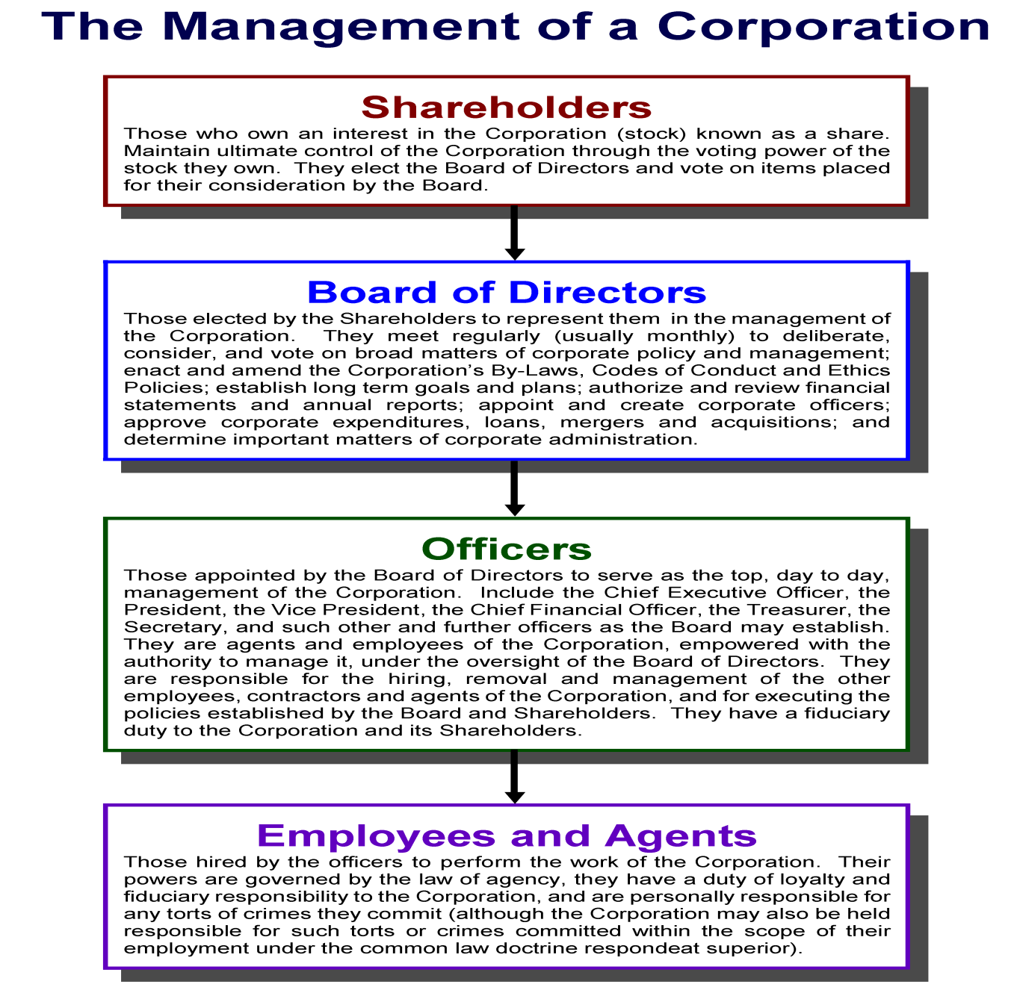

Slide 15
End of Class Eight C
For next time – Review Assignments as follows on the Webpage:
Lecture Slides
Selected Readings
Cases and Exercises
We are a hot bench.
Questions?

